Slide 1

Python Scripting with Network
Day 7

Slide 2

Agenda
Python Multithreading
Python Regular Expressions
REST API
JSON API parsing with Python
Python Request Module

Slide 3
Python Multithreading
Python multithreading allows a program to run multiple tasks concurrently within a single process. It is primarily used to improve the efficiency of I/O-bound tasks (like downloading files or web scraping), where the program spends a lot of time waiting for external resources.
Concurrency, not true Parallelism: Because of the GIL, multithreading doesn't speed up CPU-heavy math (CPU-bound tasks). Instead, it "switches" between threads very fast to hide latency during waiting periods.
Shared Memory: Unlike separate processes, all threads in one program share the same memory space, making it easy to share data but requiring Locks to prevent data corruption.
Modern Update: Newer versions like Python 3.13+ have introduced experimental "free-threaded" builds that can run without the GIL, allowing true parallel execution on multiple CPU cores.

Slide 4
Python Regular Expressions
In Python, regular expressions (regex) are handled through the built-in re module, which provides a powerful set of tools for searching, matching, and manipulating text strings based on specific patterns
re.search(): Scans through a string and returns a match object for the first location where the pattern is found.
re.match(): Checks for a match only at the beginning of the string.
re.findall(): Returns a list of all non-overlapping matches of a pattern in the string.
re.sub(): Replaces occurrences of a pattern with a specified replacement string.
re.split(): Splits a string into a list wherever the pattern matches.
re.compile(): Compiles a regex pattern into a reusable pattern object, which is more efficient if the pattern is used multiple times.

Slide 5
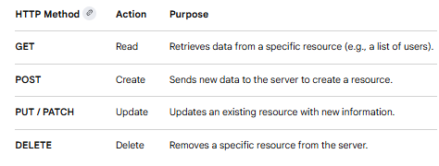
Overview of REST API
Python is one of the most popular languages for building and interacting with REST (Representational State Transfer) APIs. These APIs act as a standardized contract between different software systems, allowing them to exchange data—usually in JSON format—over HTTP.

Slide 6
JSON API for Python
Working with JSON in Python typically involves two main tasks: parsing data from an external API or building your own API that serves JSON.
json.loads(string): Decodes a JSON-formatted string into a Python dictionary or list.
json.dumps(obj): Encodes a Python object into a JSON-formatted string (useful for sending data to an API).
json.load(file) and json.dump(obj, file): Used for reading from or writing directly to .json files

Slide 7
Python Requests module
Requests is an elegant and simple HTTP library for Python, built for human beings.
The Session object allows you to persist certain parameters across requests. It also persists cookies across all requests made from the Session instance and will use urllib3’s connection pooling.
So, if you’re making several requests to the same host, the underlying TCP connection will be reused, which can result in a significant performance increase.
Whenever a call is made to requests.get() and friends, you are doing two major things. First, you are constructing a Request object which will be sent off to a server to request or query some resource.
Second, a Response object is generated once Requests gets a response back from the server. The Response object contains all of the information returned by the server and also contains the Request object you created originally.

Slide 8

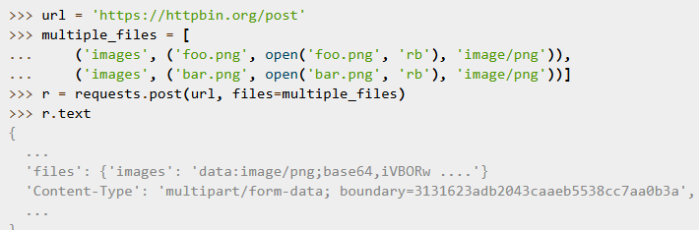
Stream Uploads
Requests supports streaming uploads, which allow you to send large streams or files without reading them into memory. To stream and upload, simply provide a file-like object for your body:
You can send multiple files in one request. For example, suppose you want to upload image files to an HTML form with a multiple file field ‘images’:

Slide 9
Python JSON Library
The Python json module is a built-in standard library tool used for parsing, serializing, and deserializing JSON (JavaScript Object Notation) data. It allows you to convert Python data structures into JSON strings or files, and vice versa.
The module revolves around four primary functions, categorized by whether you are interacting with strings or files.
json.dumps(obj): Converts a Python object into a JSON-formatted string.
json.dump(obj, fp): Serializes a Python object directly into a file.
json.loads(s): Parses a JSON-formatted string back into a Python object.
json.load(fp): Reads and deserializes a JSON file directly into a Python object.

Slide 10
Python ncclient library
In Python's ncclient library (a popular NETCONF client), "type" usually refers to the device_params argument used during connection, or the data type formats used in NETCONF RPCs (like XML).
When establishing a connection, you must pass a device_params dictionary to the manager.connect() method. This tells ncclient how to format commands for your specific networking vendor.
Common device types –
csr or iosxe (Cisco IOS-XE)
Nexus (Cisco NX-OS)
Junos (Juniper)
iosxr (Cisco IOS-XR)
Default NETCONF

Slide 11
Wrap Up
Python Automation for Network engineering
Python Network Libraries
Python Modules
Python Lambda Functions

